Slide 2


Who Is Basho?
Founded in 2008 By executives and engineers from Akamai
Creators of Riak Distributed, Highly Available, NoSQL Database. 2011 – Riak v1.0
Global Offices Seattle (HQ), Washington DC, London, Tokyo
100+ employees
Customers – 30% of Fortune 50

Slide 3


















Proven Customer Successes
Public Cloud
Gaming and Betting
Private Cloud
Telecommunications
SaaS / Data Services
Mobile Payments
Digital Media
Social Network
Display Advertising
Consumer Goods
Airlines
Health Care
On-Line Gaming
Weather
Retail and e-Commerce
PaaS Implementation
Internet of things
Supply Chain

Slide 4
2.0

Slide 5


What is Riak?
Riak is a distributed key/value database designed to deliver:
High Availability
Fault Tolerance
Massive Scalability
Operational Simplicity
Notes:
Riak is a distributed key/value database designed to deliver maximum data high availability, fault tolerance, massive scalability, and operational simplicity.

Slide 6
Key/Value
Riak stores data as a combination of keys and values in buckets:
Keys – simply binary values used to identify Objects.*
Values – can be numbers, strings, objects, binaries, etc.
Buckets – used to define a virtual namespace for storing Riak objects.
Key
Value
1
One
Json1
{
“2”:”two”,
“3”:”three”,
…
}
Image1
Image1.png
* Under the cover keys are actually stored as as combination of the bucket name and user assigned key value.
Notes:
Riak stores data as a combination of keys and values in buckets:
Keys – simply binary values used to identify Objects.*
Values – can be numbers, strings, objects, binaries, etc.
Buckets – used to define a virtual keyspace for storing Riak objects.
* Under the cover keys are actually stored as as combination of the bucket name and user assigned key value.

Slide 7
Riak’s APIs
Riak offers both HTTP and Protocol Buffers APIs. The following HTTP API example uses curl to retrieve a value by key:
curl http://127.0.0.1:8098/types/places/buckets/country/keys/US
{
"Alpha2_s": "US”, "Alpha3_s": "USA”, "EnglishName_s": "United States”, "NumericCode_i": 840 }
Note: Protocol buffers are Google's language-neutral, platform-neutral, extensible mechanism for serializing structured data – think XML, but smaller, faster, and simpler.
Notes:
Riak offers both HTTP and Protocol Buffers APIs.
Note: Protocol buffers are Google's language-neutral, platform-neutral, extensible mechanism for serializing structured data – think XML, but smaller, faster, and simpler.

Slide 8
Riak’s Operations
Get
curl http://127.0.0.1:8098/types/places/buckets/country/keys/US { "Alpha2_s": "US”, "EnglishName_s": "United States” }
Put
curl -XPUT \ -H "Content-Type: application/json" \ -d ”{‘Alpha2_s’:’US’, ‘EnglishName_s’:’United States’}" \ http://localhost:8098/types/places/buckets/country/keys/US
Delete
curl -XDELETE http://localhost:8098/types/places/buckets/country/keys/US
Notes:
Riak’s core operations against data include Get, Put, and Delete as demonstrated in these examples.

Slide 9
Riak Client Libraries
There are a diverse group of client libraries for Riak that support both the HTTP and Protocol Buffer APIs:
Basho Supported Libraries:
Java
Ruby
Python
Erlang
.Net
Community Libraries:
PHP
Node.js
C
Clojure
Go
Perl
Scala
Notes:
There are a diverse group of client libraries for Riak that support both the HTTP and Protocol Buffer APIs:
Basho Supported Libraries:
Java
Ruby
Python
Erlang
.Net

Slide 10
Availability

Slide 11

Masterless Architecture
Riak has a masterless architecture in which every node in a cluster is capable of serving read and write requests.
Clients are routed to nodes using standard load balancing appliances or software like Nginx or HAProxy.
Notes:
Riak has a master less architecture in which every node in a cluster is capable of serving read and write requests.
Clients are routed to nodes using standard load balancing appliances or software like Nginx or HAProxy.

Slide 12
Even Distribution of Data
Instead of manually sharding (partitioning) data Riak automatically distributes data evenly across a cluster by hashing keys using the SHA-1 algorithm that converts the key (bucket/key combination) into a number from:
0 - 1,461,501,637,330,902,918,203,684,832,716,283,019,655,932,542,976
or
0 - 2¹⁶⁰
Notes:
Instead of manually sharding data Riak automatically distributes data evenly across a cluster by hashing keys using the SHA-1 algorithm that converts the key (bucket/key) into a number from:
0 to 2 to the 160th

Slide 13
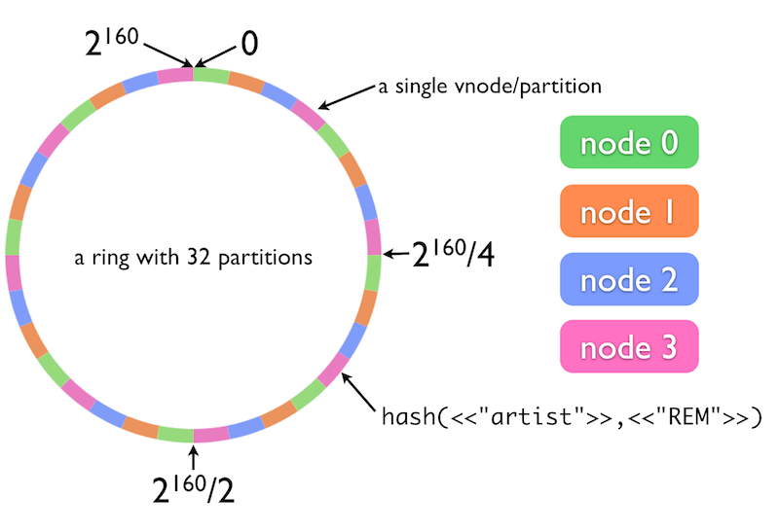
Consistent Hashing – The Ring
Notes:
Riak splits the total number of possible keys (2^160th) into equal ranges or partitions that are then assigned to each node in the cluster in turn until all of the partitions in the ring have been claimed.
Here we have four nodes (0 through 3)
* The entire keyspace for a cluster can be split into 2^160th possibilities
* That keyspace is chunked into partitions. There are 32 partitions in this diagram
* Each of the four color coded nodes is responsible for a quarter of those partitions, and partition ownership is alternated sequentially around the ring
If a bucket and key combination like “artist” and “REM” is stored in this cluster, it might land on a partition in node 3
The 2 additional copies of that piece of data would land on the next two sequential partitions (belonging to nodes 0 and 1 in this case)

Slide 14
Replication of Data
By default data written to Riak will be replicated to three (3) nodes in the cluster ensuring data remains available if one or more nodes fail.
put(“bucket/key”)
Notes:
By default data written to Riak will be replicated to three (3) nodes in the cluster ensuring data remains available if one or more nodes fail.

Slide 15
Gossip Protocol
Riak uses a “gossip protocol” to communicate the ring state and bucket properties around the cluster. Nodes periodically send their current view of the ring state to a randomly selected peer.
Notes:
Riak uses a “gossip protocol” to communicate the ring state and bucket properties around the cluster. Nodes periodically send their current view of the ring state to a randomly selected peer.

Slide 16
Hinted Hand Off
Hinted handoff allows Riak nodes to temporarily take over storage operations for a failed node and update that node with changes when it comes back online.
put(“bucket/key”)
Notes:
Hinted handoff allows Riak nodes to temporarily take over storage operations for a failed node and update that node with changes when it comes back online.

Slide 17
Fault Tolerance

Slide 18
Read Repair
Read repair occurs when a successful read occurs but not all replicas agree on the value to return. Replicas found to be missing data or out of sync are repaired using data from the healthy replicas.
get(“bucket/key”)
Notes:
Read repair occurs when a successful read occurs but not all replicas agree on the value to return. Replicas found to be missing data or out of sync are repaired using data from the healthy replicas.

Slide 19
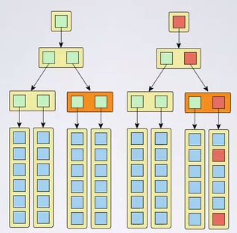
Active Anti-Entropy
AAE is a background process that compares Merkle trees to identify variations between nodes and trigger repair operations when errors are located.
Notes:
AAE is a background process that compares Merkle trees to identify variations between nodes and trigger repair operations when errors are located.

Slide 20
Conflict Resolution
Dotted Version Vectors are a tool used by Riak to track the logical sequence of updates to a key/value pair (versus the chronological order of events) and manage the process of merging siblings created as one of the side effects of eventual consistency.
A:1
B:1
A:1
C:1
B:1
?
C:2
B:1
?
N:1
?
Notes:
Dotted Version Vectors are a tool used by Riak to track the logical sequence of updates to a key/value pair (versus the chronological order of events) and manage the process of merging siblings created as one of the side effects of eventual consistency.
It is important to note that you should always read an object prior to updating it unless you are certain that no object is stored there. That said there are also tools that you can use when avoid siblings is useful like the Clobber and No-Operation updates in the Java client.

Slide 21
Siblings in Practice
> curl http://127.0.0.1:8098/types/places/buckets/country/keys/US Siblings: 47fGOQwxRzq6wsbM7idvFB 2mJD0DEGoxdxdHUqS3bYt3 7Y68tqVG99xHBDu7AKtmb4
> curl -H "Accept: multipart/mixed" http://127.0.0.1:8098/types/places/buckets/country/keys/US
--RigRoRk6lkPXYIqBOv1jKEacnlr Content-Type: application/json Link: </buckets/country>; rel="up” Etag: 47fGOQwxRzq6wsbM7idvFB Last-Modified: Wed, 05 Nov 2014 22:44:00 GMT {"Alpha2_s":"US","Alpha3_s":"USA","EnglishName_s":"United States","NumericCode_i":840} --RigRoRk6lkPXYIqBOv1jKEacnlr Content-Type: application/json Link: </buckets/country>; rel="up”
...

Slide 22
Scalability & Operational Simplicity

Slide 23


Scalability
“To enable rapid iteration at scale, Riot moved to Riak to support millions of concurrent players at any moment.”
Linear Scaling Riak scales in a near-linear fashion so increasing the number of a nodes in a cluster increases the number of reads and writes a cluster can handle in a predictable fashion.
If 10 nodes can serve: 40,000 Writes/Second
Then 20 nodes should serve: 72,000+ Writes/Second
Notes:
Primary Riak Cluster (h1.4xlarge in AWS):
* 20 nodes, burst up to 5,000 reads / sec per node, 750 writes / sec
* Mean get latency < 2ms, 95th percentile < 10ms
* 100% availability for over 8 months & counting
* Well below our theoretical capacity. System effectively "idles" at its current pace.

Slide 24
Add/Remove/Replace Nodes
> riak-admin cluster join riak@192.168.2.2
> riak-admin cluster plan
> riak-admin cluster commit
> riak-admin cluster leave riak@192.168.2.5
> riak-admin cluster plan
> riak-admin cluster commit
> riak-admin cluster join riak@192.168.2.2
> riak-admin cluster replace riak@192.168.2.4 riak@192.168.2.7
> riak-admin cluster plan
> riak-admin cluster commit
Notes:
Adding nodes to a cluster uses the riak-admin command as shown here. When joining a new node to a cluster with the join command the node specified is an existing node in the cluster that will be contacted to handle the cluster communication associated with joining the cluster. Any existing node can perform this task.
Note:
The algorithm that distributes partitions across the cluster during membership changes is non-deterministic. As a result, there is no optimal ring. In the event that a plan results in a slightly uneven distribution of partitions, the plan can be cleared. Clearing a cluster plan with riak-admin cluster clear and running riak-admin cluster plan again will produce a slightly different ring.

Slide 25

Operational Simplicity
Runs on Commodity Hardware
All Nodes are Created Equal
Support for Rolling Upgrades (within 2 feature releases, i.e. 2.0 to 2.2)
Scales Up (and Down) Quickly and Easily
Self Healing Mechanisms Limit Need for Manual Intervention
Erlang OTP (Open Telecom Platform) Allows for Hotfixes
“By far our biggest problem with Riak is that we don’t have problems with Riak“
1/5 operations personnel required vs Apache Cassandra
80% Reduced Total Cost of Ownership vs. Oracle
Notes:
Riak is simple to operate
Allows vast scalability on cheap hardware
Masterless architecture means no special considerations when adding capacity
If you get a notification about a downed node at 3am, most of the time you can go back to sleep as an operator
Erlang OTP features allow for adding patches and fixes on a running cluster

Slide 26

"Two years ago, we implemented Riak due to its high availability, operational simplicity, and ability to scale," said Wes Jossey, Head of Operations at Tapjoy. "When we began, our clusters typically moved around 40,000 operations per second at peak. Today, we now see peaks well over 250,000 operations per second, all while sustaining sub millisecond response times and rock solid stability. Despite this massive change in growth, we still do not employ any full time engineer to work on our Riak cluster. It's really that easy to use.”
Notes:
"Two years ago, we implemented Riak due to its high availability, operational simplicity, and ability to scale," said Wes Jossey, Head of Operations at Tapjoy. "When we began, our clusters typically moved around 40,000 operations per second at peak. Today, we now see peaks well over 250,000 operations per second, all while sustaining sub millisecond response times and rock solid stability. Despite this massive change in growth, we still do not employ any full time engineer to work on our Riak cluster. It's really that easy to use.”

Slide 27
Advanced Features

Slide 28
Riak Search 2.0
Riak Search 2.0 (codename Yokozuna) integrates Apache Solr in a distributed fashion offering:
Support for various MIME types (JSON, XML, plain text, Riak Data Types) for automatic data extraction
Support for various language-specific analyzers, tokenizers, and filters
Robust, easy-to-use query languages like Lucene (default) and DisMax
Query result highlighting
Queries: exact match, globs, inclusive/exclusive range queries, AND/OR/NOT, prefix matching, proximity searches, term boosting, sorting, pagination
Protocol Buffer interface and Solr interface via HTTP
Scoring and ranking for most relevant results
Active Anti-Entropy for automatic index repair

Slide 29
Write Like Riak, Read Like Solr
curl "$RIAK_HOST/search/famous?wt=json&q=name_s:Lion*" | jsonpp
will return:
{
"numFound": 1,
"start": 0,
"maxScore": 1.0,
"docs": [
{
"leader_b": true,
"age_i": 30,
"name_s": "Lion-o",
"_yz_id": "default_cats_liono_37”,
"_yz_rk": "liono”, "_yz_rt": "default”, "_yz_rb": "cats” } ] }
Lucene similarity score
Array of matching documents
Riak key
Bucket type
Bucket

Slide 30
Riak Data Types
Riak Data Types (Convergent Replicated Data Types or CRDTs) are a developer-friendly way to keep track of updates in an eventually consistent environment:
Counter Keeps tracks of increments and decrements on an integer
Flag Values limited to enable or disable
Set A collection of unique binary values that supports add and remove operations on one or more values
Map Supports the nest of and of the Riak Data Types.
Register A named binary field that can only be used as part of a Map.

Slide 31
Riak Data Types
Riak Data Types have built-in conflict resolution rules which are summarized below:
Data Type | General Rule
Flags | enable wins over disable.
Registers | The most chronologically recent value wins, based on timestamps.
Counters | Each actor keeps an independent count for increments and decrements. Upon merge, the pairwise maximum of any two actors will win (e.g. if one actor holds 172 and the other holds 173, 173 will win upon merge).
Sets | If an element is concurrently added and removed, the add will win.
Maps | If a field is concurrently added or updated and removed, the add/update will win.

Slide 32
Strong Consistency*
Riak 2.0 introduces the option to store data in a strongly consistent fashion (consistent plus partition tolerant or CP) for some or all of your data:
Guarantees that applications can read their own writes but sacrifices availability
Small (up to a few milliseconds) performance hit on reads and writes
Strong consistency can be enabled on a bucket by bucket basis using Bucket Types
* Riak's strong consistency feature is currently an open-source-only feature and is not yet commercially supported.

Slide 33
Strong Consistency*
There are four types of atomic operations provided in Riak 2.0:
Get
Conditional Put (Write if does not already exist)
Conditional Modify (Read, Modify, Write)
Delete

Slide 34
Security
In addition to SSL Riak 2.0 now supports Authentication and Authorization:
PAM supports integration with other authentication platforms, such as LDAP.
Although groups of users may be granted functional permissions, authentication must be at the individual level.
Users may be assigned to one or more groups for convenience in managing permissions.
Permissions are set at the bucket type level or as a global setting for all buckets.

Slide 35
Riak Backends
Pluggable storage backends are a key feature of Riak. They enable you to choose a low-level storage engine that suits specific use cases.
Bitcask Basho’s open source key/value store and Riak’s default backend.
LevelDB Google’s open source key/value store
In Memory Uses Erlang’s ets tables to store data in memory
Multi-Backend Select the right backend for each use case on a bucket by bucket basis
Notes:
Pluggable storage backends are a key feature of Riak. They enable you to choose a low-level storage engine that suits specific use cases.
Bitcask Basho’s open source key/value store and Riak’s default backend.
LevelDB Google’s open source key/value store
In Memory Uses Erlang’s ets tables to store data in memory
Multi-Backend Select the right backend for each use case on a bucket by bucket basis

Slide 36
Riak Backends
Feature | Bitcask | LevelDB | Memory
Default Riak Backend | X
Persistent | X | X
Keyspace in RAM | X |  | X
Keyspace > Available RAM |  | X
Keyspace Loaded to RAM on Startup | X
Objects in RAM |  |  | X
Object Expiration | X |  | X
Secondary Indexes |  | X | X
Tiered Storage |  | X

Slide 37
2.0
Enterprise

Slide 38
Riak Enterprise
Multi-Data Center Replication
SNMP and JMX Monitoring
24X7 Support from Basho

Slide 39






Riak Multi-Datacenter (MDC) Replication
Riak automatically replicates between clusters
Geo-Data Locality allows localized data processing
Configurable number of remote replicas
Options for real-time sync and full sync
Spanning tree support for cascading replication
Reduced latency to end-users
Allows sub 5ms responses
Active-Active ensures continuous user experience

Slide 40


Slide 41
Riak CS (Cloud Storage) is easy-to-use object storage software built on top of Riak, Basho's distributed database. Riak CS is designed to provide simple, available, distributed cloud storage at any scale, and can be used to build cloud architectures—be they public or private—or as storage infrastructure for heavy-duty applications and services. Riak CS's API is Amazon S3 compatible and supports per-tenant reporting for use cases involving billing and metering
Notes:
Riak CS (Cloud Storage) is easy-to-use object storage software built on top of Riak, Basho's distributed database. Riak CS is designed to provide simple, available, distributed cloud storage at any scale, and can be used to build cloud architectures—be they public or private—or as storage infrastructure for heavy-duty applications and services. Riak CS's API is Amazon S3 compatible and supports per-tenant reporting for use cases involving billing and metering

Slide 42
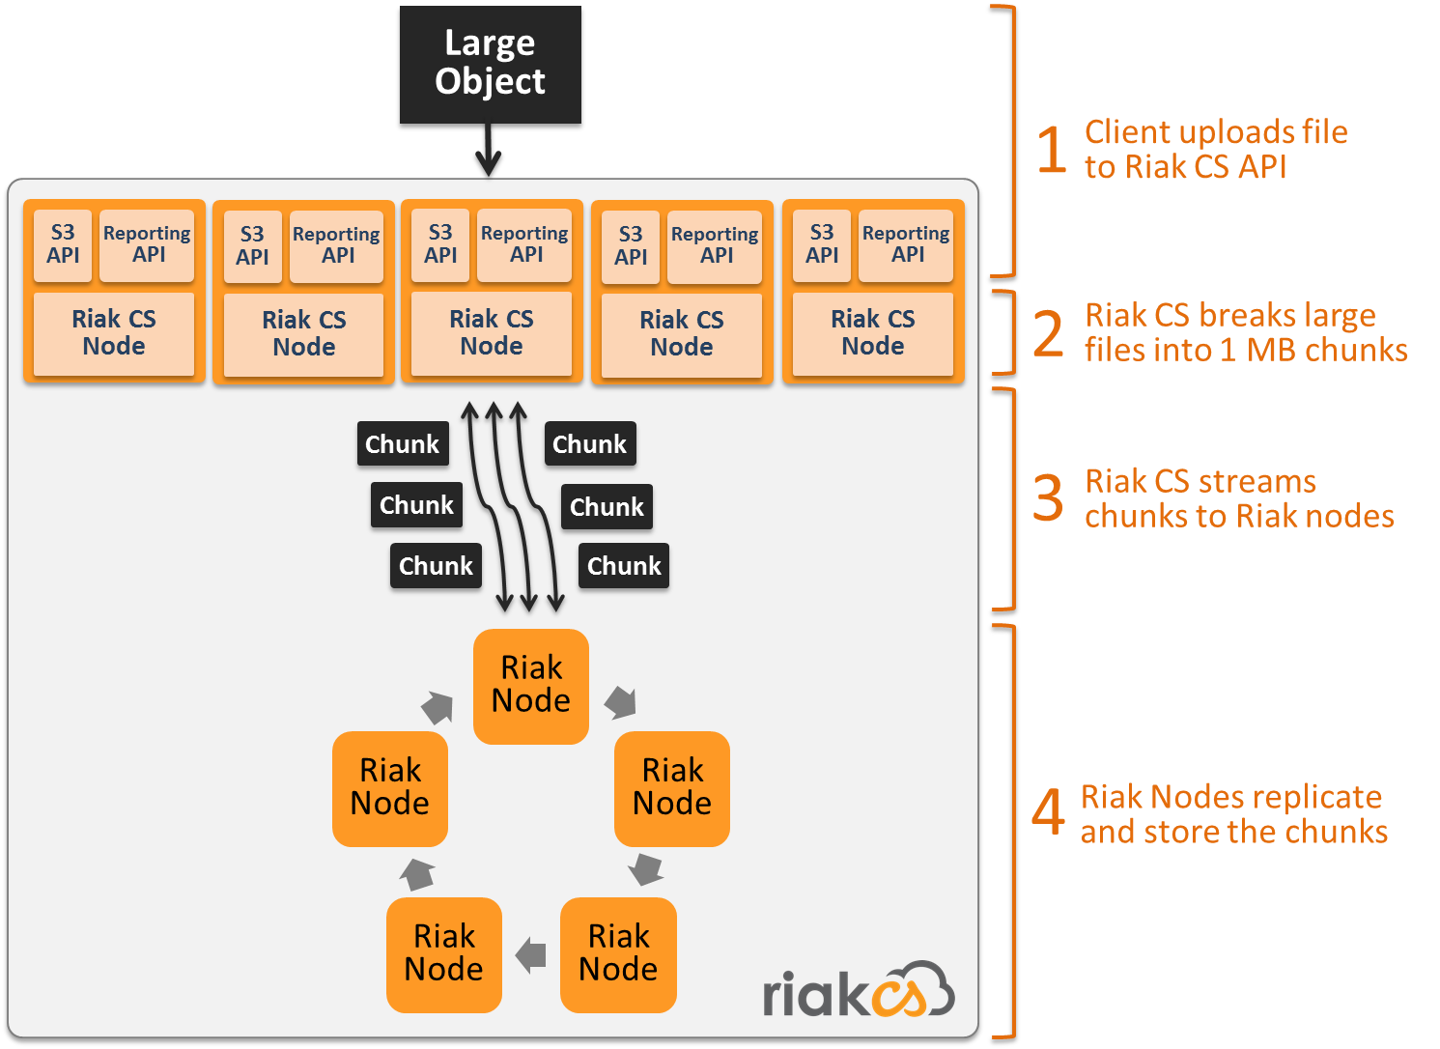
How RiakCS Works
Now Supporting AWS S3 and OpenStack Swift API
Notes:
CS is an API layer on top of a normal Riak cluster.
It takes large files and breaks them into 1MB chunks and stores each of those as separate keys
On read the chunks are reassembled to return the complete object

Slide 43
Features and Benefits
Feature | Description | Business value
Reliability | Highly available, fault‐tolerant storage | Store mission critical data and not worry about data loss
Large object support | Store objects up to 5GB for single upload and 5TB for multi-part upload | Large Object Storage
Interoperability | - S3‐compatible API and authentication - OpenStack integration, Object Storage API - Keystone authentication service | Easily support hybrid cloud environment
User management | Multi‐tenancy with per-user reporting on usage and network I/O | Control data growth by monitoring “per-user consumption" or similar.
Scalability | Simple operational model for adding capacity | Scale up and down as needed to meet business needs
Multi-data center replication | Multi‐datacenter replication for active backups, disaster recover, and data locality | MDC support to prepare for disasters

Slide 44
Riak CS 1.5+ Improvements
Feature | Description | Business value
Admin Tooling | Command line tools for administrators and syslog output | Simplify administrative tasks, including cluster management, monitoring and troubleshooting
Additional s3 Support | Add support for multi-object delete, cache control headers and PUT object copy | Improve compatibility with S3 API, allowing customers to use existing investments in tools
Increased Scalability | Increase scalability of Riak CS to 10 PB | Enable customers to plan for data growth.
Improved garbage collection | Improved speed of garbage collection of deleted objects by 14-15% | Improve storage efficiency and performance
Notes:
We saw an improvement in garbage collection max throughput from 2.1TB/day at the disk on 1.4.5 to 32TB/day at the disk on a 6-node cluster built from AWS hi1.4xlarge machines with 16 CPUs, 10GbE NICs and a RAID0 of 2x1TB SSDs for storage

Slide 45
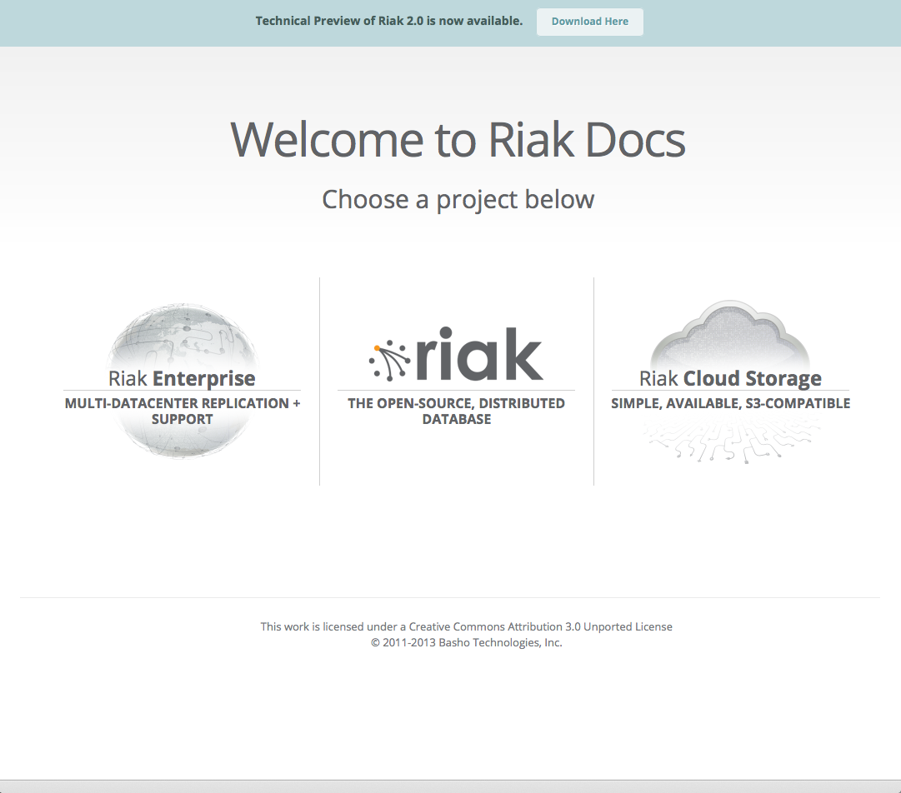
More Information
Everything Riak: docs.basho.com
Resources: basho.com/resources/
Hangouts: youtube.com/BashoTechnologies
About Distributed Systems: ricon.io
Online Books: littleriakbook.com
Sign Up for a free Riak Tech Talk: basho.com

